Slide 1
COGS 9 – Introduction to Data Science
Discussion Section 6

Slide 2
Today’s Agenda:
Reading 1: Data is Personal: Attitudes and Perceptions of Data Visualization in Rural Pennsylvania
Reading 2: Graphical Inference for Infovis
Q/A

Slide 3
Upcoming Deadlines:
Quiz 4 due this Friday (February 23)
Assignment 2 due on Monday (February 26)

Slide 4
Reading 1: Attitudes and Perceptions of Data Visualization
Overall, the paper emphasizes the importance of considering the unique challenges and profiles of underrepresented populations, particularly rural communities, when studying attitudes, biases, and literacy in data visualization. By addressing these issues, data visualization can become a powerful tool for empowering individuals in underrepresented communities to understand and engage with data effectively.

Slide 5
Background
Encounters with data can be manipulated by several factors:
Experience or education
Biases
Attention
Focus on people in rural settings is motivated by
The population's absence in the visualization literature
Gaps in education, income
Literacy may impact perceptions of data visualizations

Slide 6
Goal of the study: Identify which factors drive attention and trust in rural populations with diverse economic and educational backgrounds - an underrepresented population in the data visualization literature
What did the authors do in this study to answer this question?

Slide 7
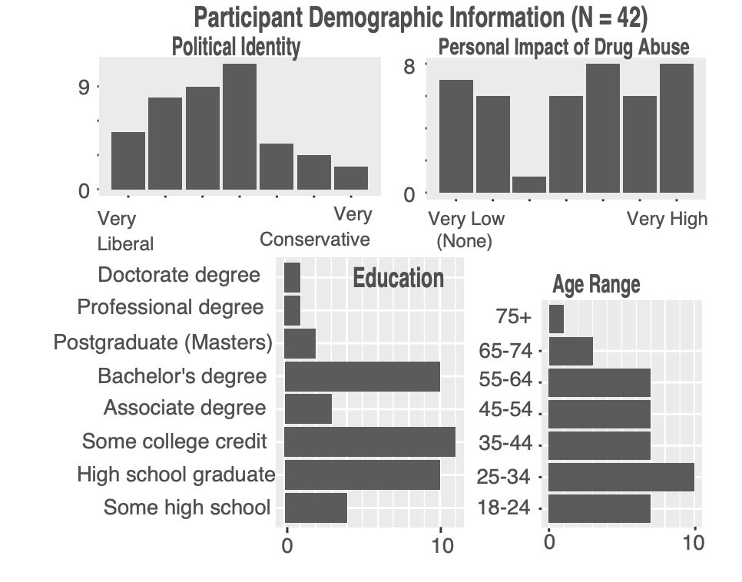
Interviews in rural Pennsylvania
Participants: 42 rural individuals of varied economic, demographic backgrounds
Procedure:
1. Introduction and consent
2. Graphs presentation and ranking. Asked the participants:
“Based on how useful they are to you, arrange the graphs from most useful to least useful”
Notes:
The authors performed a series of interviews with community members in central Pennsylvania with the goal of capturing initial perceptions of data visualization.

Slide 8
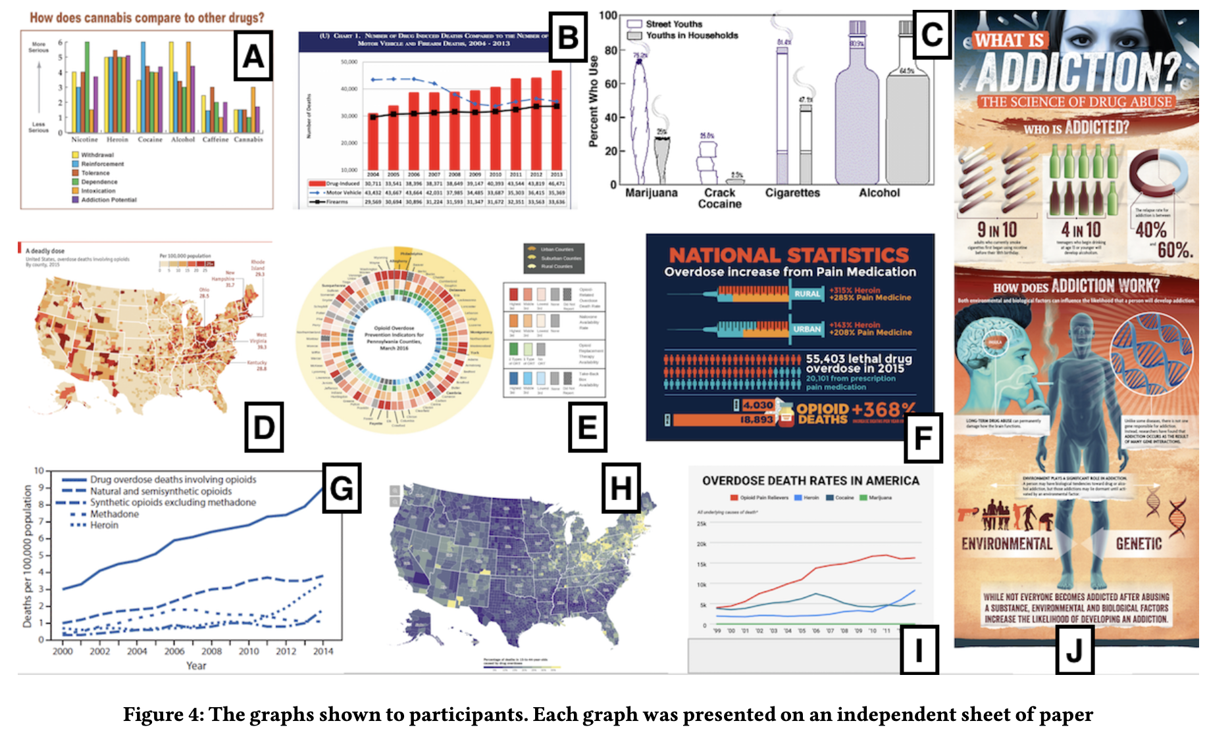
Notes:
A, B – Bar
C – Isotype (kind of like a pictogram)
D,H – Map
E – Heat map
F,J – Infographic
G, I - Line

Slide 9
Interviews in rural Pennsylvania (cont.)
Semi-structured interview: After participants rank the visualizations a semi-structured interview is conducted effectively asking them why they made the rating they did.
Transcripts of the conversations were coded for participant explanations.
Example codes include Colorful (29) , Confusing (29), Clear (26), Simple (26), Relatable (21), Attractive (20), Informative (19), Cluttered (17)
Notes:
Since the interview was semi-structured, not every person made a comment on every graph

Slide 10
Interviews in rural Pennsylvania (cont.)
Source reveal: Sources of the data were shown to participants after they had ranked the graphs. The participants looked at the sources and were then asked if they wanted to change their rankings.
This investigated whether certain demographics care about data sources more than others.
Demographic questions – asked at the very end of the experiment. Questions include age, education history, political identity
Notes:
Demographics were collected after the interview to prevent priming participant responses

Slide 11
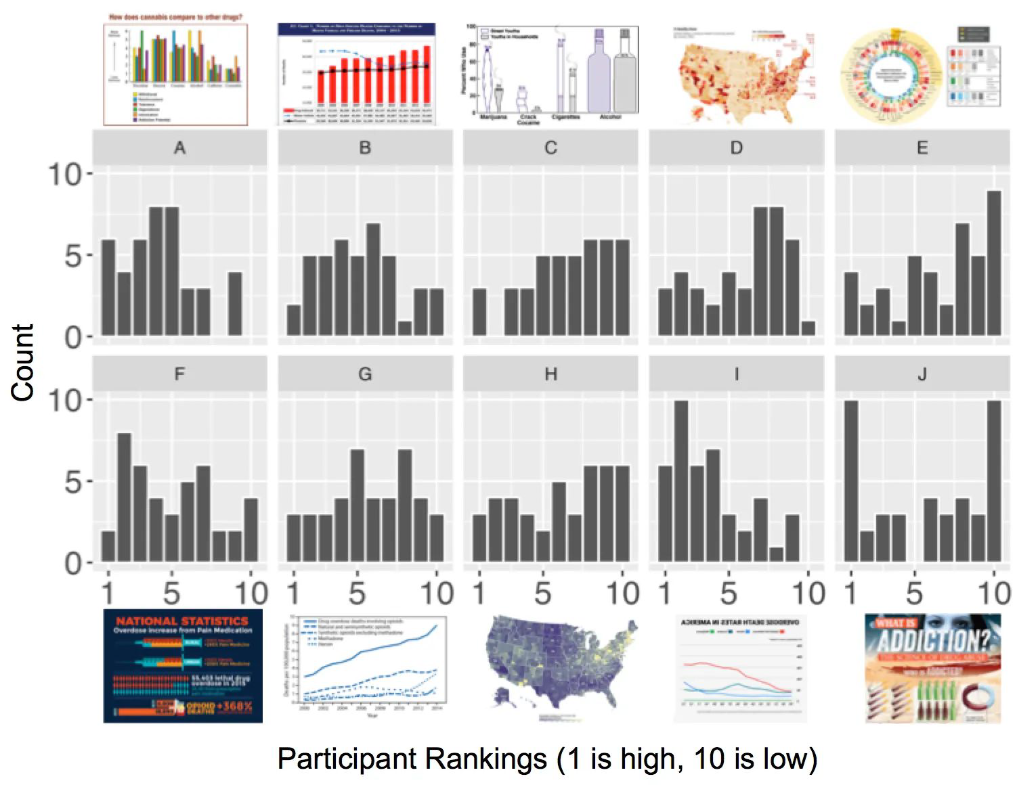
Participants Ranking
Graphs provoked diverse opinions
Infographics (Graphs F and J) yielded the most polarizing opinions
Simple bar graphs and line graphs most popular (A, B and I)

Slide 12
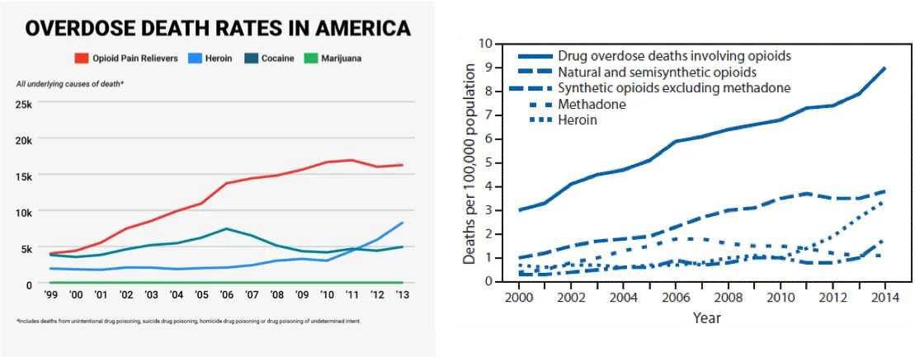
Ranking Results
Reasons people rank graphs highly:
Simplicity, clarity, and aesthetics influenced rankings. Simple bar graphs (Graphs A, B) and line graphs (Graph I) were amongst the highest ranked charts.
Good use of color: Comparing two line graphs, many participants thought color was a good reason to prioritize Graph I over Graph G, likely due to color making Graph I easier to parse

Slide 13
Ranking Results
Personal history: Biggest theme in the results is that interpretation of figures is personal to the individual’s history and their biases
Example 1: personal impact of topics such as opioid abuse, will shift opinion for or against certain graphs that relate to this topic. Graph G is highly rated cause it focused on opioid abuse, a common issue among these 42 rural participants or their friends and family.
Example 2: Another example is the ease of locating the home of the participant. A graph which easily shows the home state / city of the participant will be rated higher.
“I have a few friends that died [from drug overdoses] so [Graph F] made me put it that way”
“Well [Graph J] obviously gets me because I drink and smoke.”
“[I ranked Graph I higher] just for the simple fact that I live in America so I thought it was pretty relevant...more than the other
one [Graph G].”

Slide 14
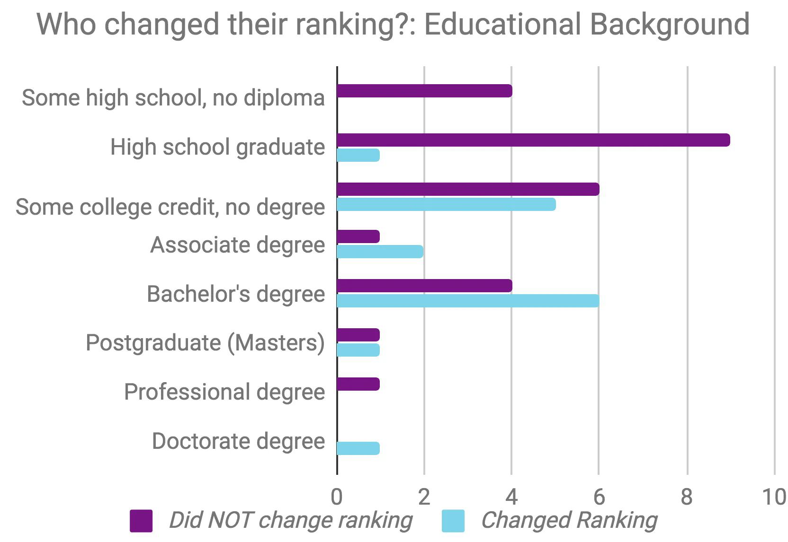
After revealing sources
More educated participants were more likely to change their rankings after seeing the graph’s source.
Reasons people don’t change rankings after source is revealed. The authors suggest this is because of two effects:
"objectivity of data”: To this group, the data is the data, the source doesn't matter
"anchoring effect”: Individuals are not as willing to change their opinion once decided

Slide 15
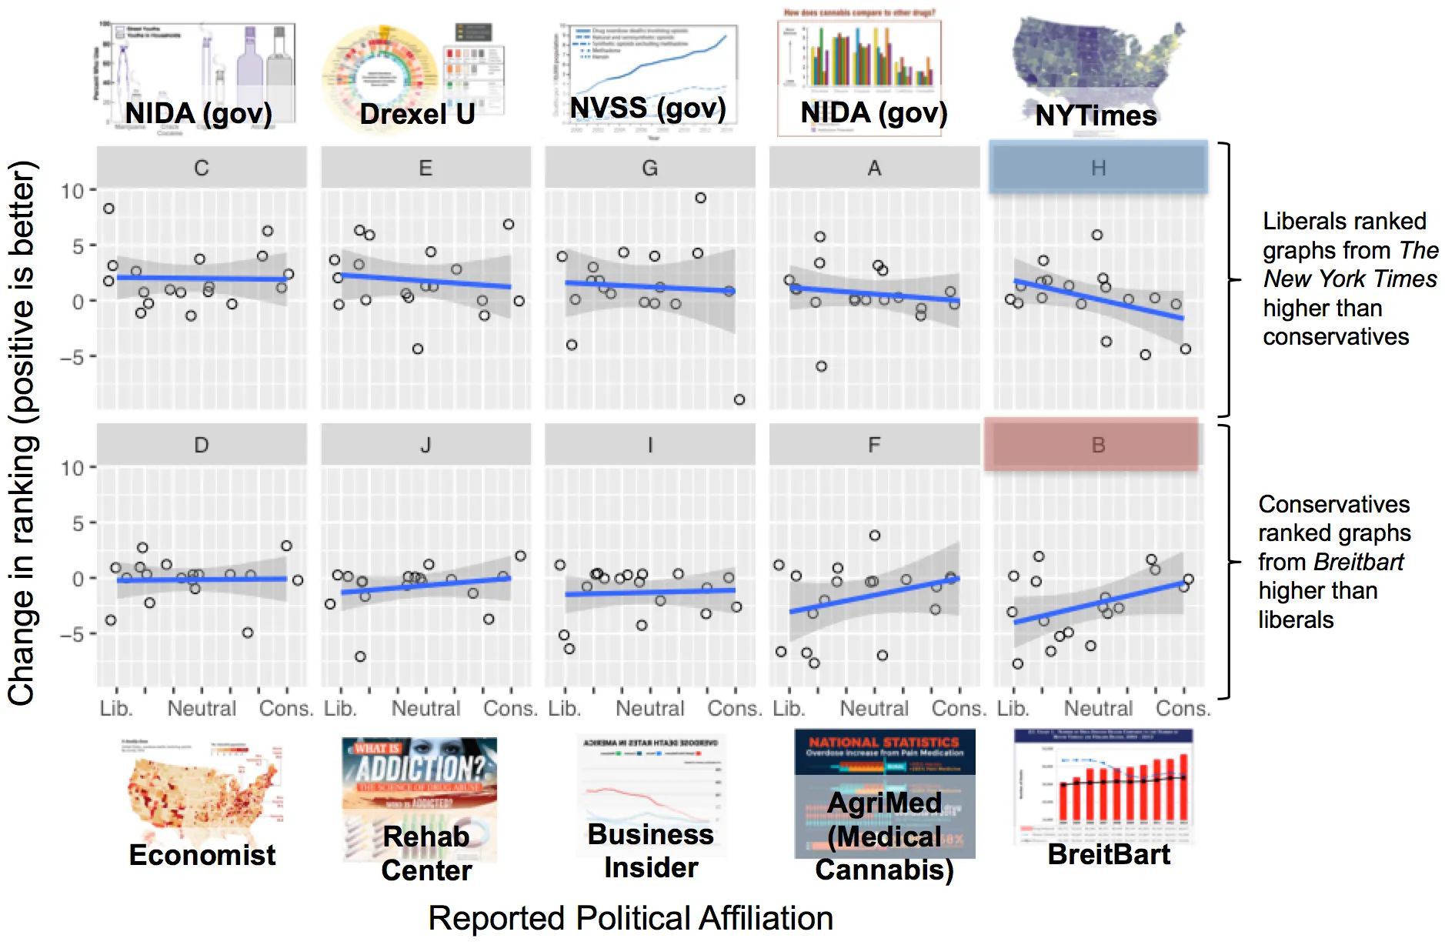
Ranking Change vs Political Affiliation
Notes:
Let’s see how people changed rankings vs what their political affiliations are:
Breitbart (B), for example, is a far-right news outlet that drew lower rankings from participants who identified as liberals. The authors also saw similar trends with AGRiMED, a licensed medical cannabis cultivation company - liberal participants were more likely to drop their ranking of the data visualization.
While these results are not surprising, we must consider how political biases and beliefs may negate the impact of even the most lauded institutions for data visualization design and implementation, such as The New York Times (H), conservatives ranked it low.

Slide 16

Discussion Question
Look over the graphs again (open up the paper if possible). What figures do you personally dislike and why?

Slide 17
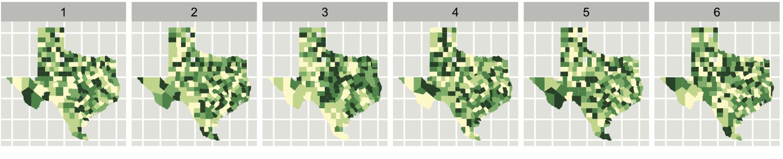
Reading 2: Graphical Inference for Infovis
Relates statistical inference to a new idea “Graphical inference for Infovis” (Information Visualization)
Main idea: If we can detect a real visualization in a randomly ordered list of fake visualizations, we can determine the real one is significantly different than the fake ones.
Notes:
These six plots show choropleth maps of cancer deaths in Texas, where darker colors = more deaths. Can you spot which of the six plots is made from a real dataset and not simulated under the null hypothesis of spatial independence?

Slide 18
Why do we need statistical inference
Two components of statistical inference:
Testing (is there a difference?)
Estimation (how big is the difference?)
We don’t want our conclusions to apply only to a small sample, but a large fraction of humanity
For graphics, we want to address the question “Is what we see really there?”
In other words, “Is what we see in a plot of the sample an accurate reflection of the entire population?”

Slide 19
Criminal Justice Analogy for Hypothesis Testing
The accused (data set) will be judged guilty, or innocent based on the results of a trial (statistical test)
Each trial has a defense (advocating for the null hypothesis) and a prosecution (advocating for the alternative hypothesis)
On the basis of how evidence (the test statistic) compares to a standard (the p-value), the judge makes a decision to convict (reject the null) or acquit (fail to reject the null)
Notes:
If you have a lot of evidence, then the judge goes with prosecution – decides to convict (reject the null hypothesis)
In case of lack of evidence, we will acquit the accused (fail to reject the null hypothesis)

Slide 20
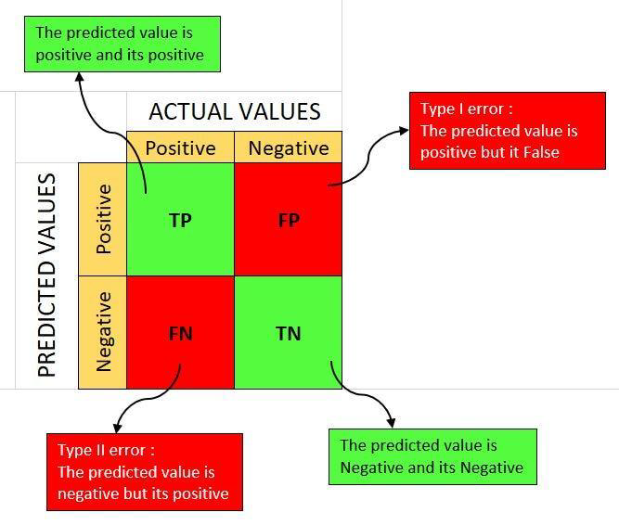
True Positives, True Negatives, False Positives, False Negatives & Confusion Matrices
Mistakes that can occur:
We can acquit a guilty person (a type II error, or false negative)
Falsely convict an innocent person (a type I error, or false positive)
Cost of these mistakes is not equal, can vary based on the situation
Notes:
costs of these two mistakes are not equal and vary based on the severity of the consequences (the risk of letting a guilty shoplifter go free is not equal to the risk of letting a guilty axe-murderer go free). Typically, as the consequences of our decisions become bigger, we want to become more cautious, and require more evidence to convict.

Slide 21
Graphical Inference
Helps us answer the question: “Is the relationship we are observing really there?”
It allows us to control for apophenia (the innate human tendency to see patterns within noise)
Traditionally,
Infovis has been concerned with discovering new relationships (curiosity)
statistics has been concerned with preventing spurious relationships from being reported (skepticism)
Graphical inference bridges the gap between curiosity and skepticism

Slide 22
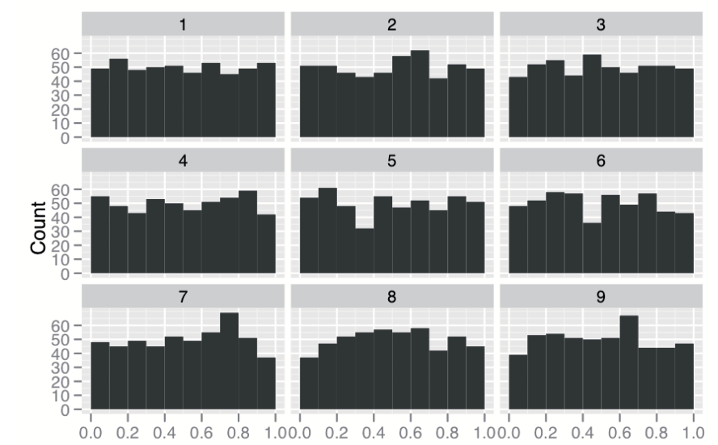
Protocols of Graphical Inference
Rorschach Protocol:
A calibrator that helps an analyst become accustomed to the peculiarities of random data
We use this protocol to calibrate our vision to the natural variability in plots in which the data is generated from scenarios consistent with the null hypothesis
Helps us learn which random features we might spuriously identify
Figure: Nine histograms summarizing the accuracy at which 500 participants perform nine tasks
Demonstrates to the viewer what normal variability looks like under the null hypothesis
Notes:
Looking at these graphs we might think that In task 7 accuracy peaks around 70% and drops off; in task 5, few people are 20-30% accurate; in task 9, many people are 60-70% accurate
It may come as a surprise, but these results are all simulations from a uniform distribution, that is, the distribution of accuracy for all tasks is uniform between 0 and 1
Demonstrates to the viewer what normal variability looks like under the null hypothesis , there is no difference in the distribution in these images

Slide 23
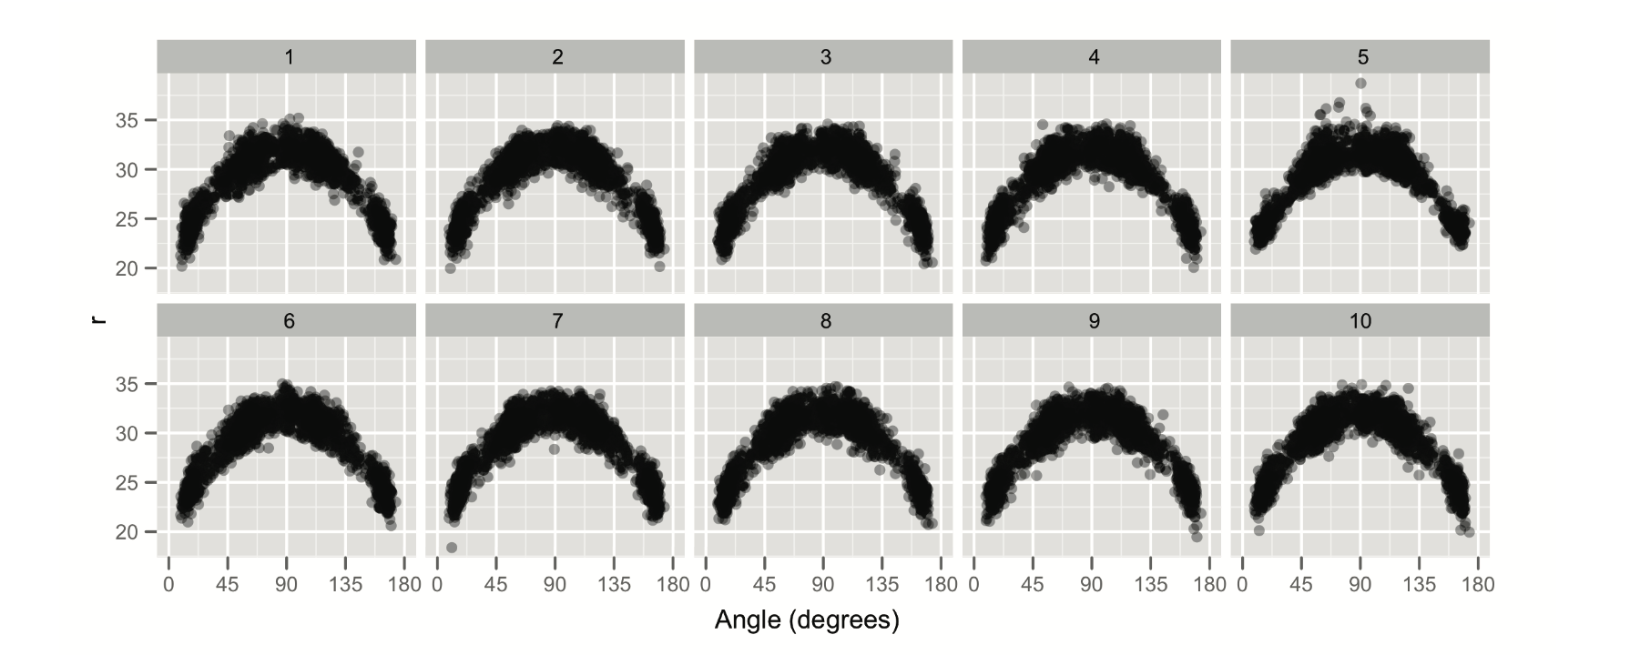
Protocols of Graphical Inference
Line-up Protocol:
Provides a simple inferential process to produce a valid p-value for a data plot
Generate n-1 decoys (null data sets)
Make plots of the decoys and randomly position a plot of true data
Can the observer spot the real data? (we reject the null hypothesis if they can)
Works like a police lineup(the suspect is hidden in a set of decoys)
Notes:
The graph shows the data on all three pointers attempted by the Los Angeles Lakers in the 2008/09 season. Scatterplot of distance vs. angle for three pointers. True data is concealed in this line-up of nine plots generated under the null hypothesis that there is a quadratic relationship between angle and distance.

Slide 24
Common Examples for Line-up Protocol
If we are interested in the spatial trend in a data map, then the null hypothesis might be that location and value are independent
To generate null datasets, we permute the value column
In a scatterplot, an initial hypothesis might be that there is no relationship between x and y
We can generate null hypotheses by permuting either the x or y variables
If we have clustered the data and are displaying the results with a colored scatter, we might be interested to know is the clusters are well separated
The null hypothesis is that clutter membership and position are independent, and we can generate null datasets by permuting the cluster id column

Slide 25
Power of a Statistical Test
Power: the probability of correctly “convicting” a “guilty dataset”
Perception psychology guides the choice of effective plots to detect specific structure
Mapping variables to perceptual properties aids accurate interpretation
Aggregation(summarizing or combining data points into a smaller set of representative values) improves structure detection in large datasets
Notes:
The capacity to detect specific structure in plots can depend on many things, including an appropriate choice of plot, which is where the psychology of perception is very important. We should map variables to perceptual properties to maximize the reader’s chances of accurately interpreting structure. For example, we should map our most important continuous variables to position along a common scale, and to use pre-attentive attributes, such as color, to represent categorical information like groups.

Slide 26
Questions?

